Slide 1
Objectives
Explore how to storyboard a Web site
Create navigation lists
Create links between documents in a Web site
Understand absolute and relative folder paths
Set a base path
Mark a location with the id attribute
Create a link to an id

Slide 2
Objectives
Mark an image as a link
Create an image map
Understand URLs
Link to a resource on the Web
Link to an e-mail address
Work with hypertext attributes
Work with metadata

Slide 3
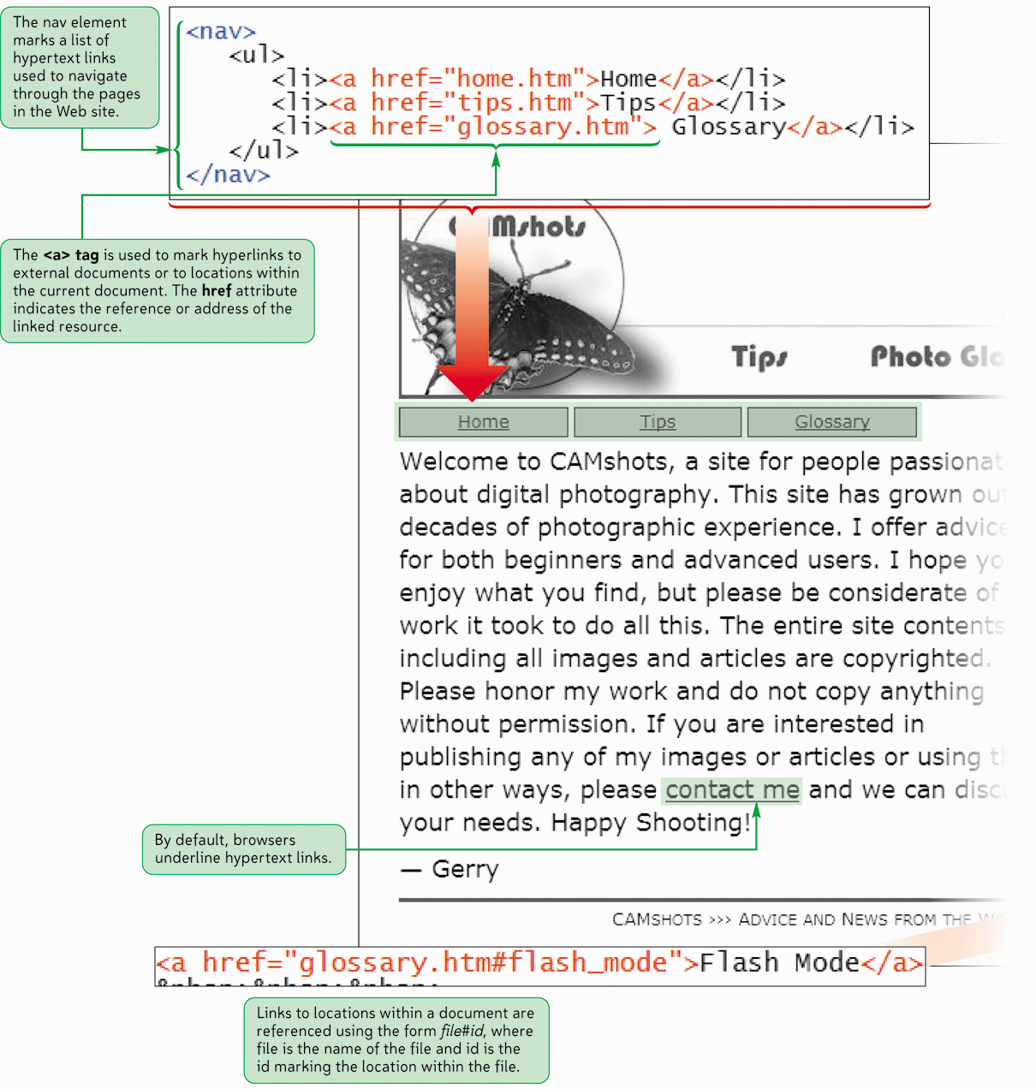
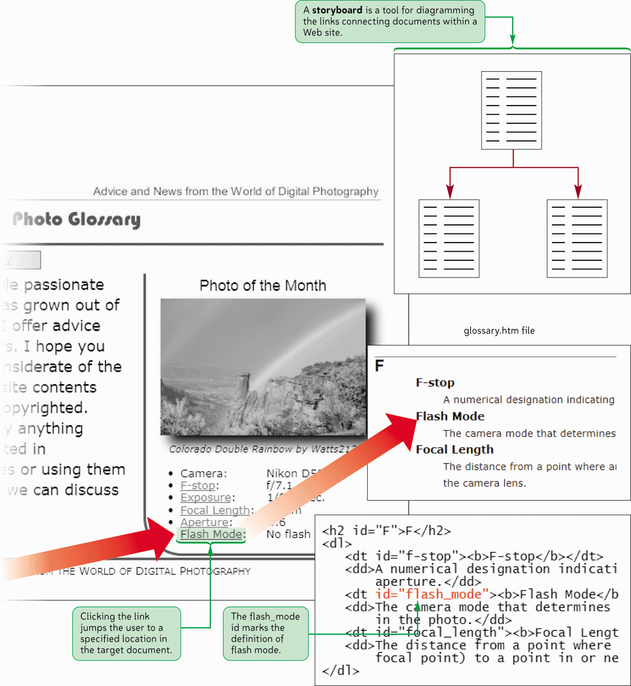
Creating Hyperlinks

Slide 4
Exploring Web Site Structures
A storyboard is a diagram of a Web site’s structure, showing all the pages in the site and indicating how they are linked together
It is important to storyboard your Web site before you start creating your pages in order to determine which structure works best for the type of information the site contains
A well-designed structure can ensure that users will be able to navigate the site without getting lost or missing important information

Slide 5
Linear Structures
In a linear structure, each page is linked with the pages that follow and precede it
Linear structures work for Web sites that are small in size and have a clearly defined order of pages
In an augmented linear structure, each page contains an additional link back to an opening page

Slide 6
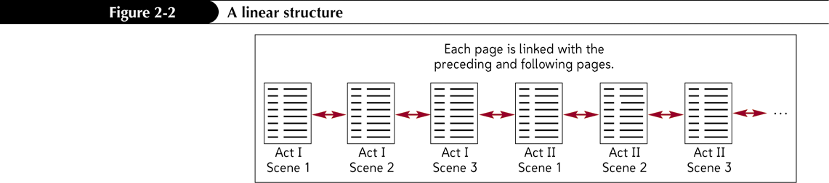
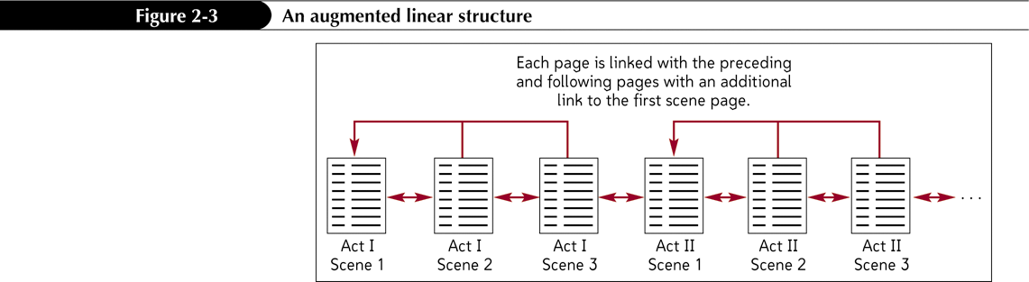
Linear Structures
A linear structure
An augmented linear structure

Slide 7
Hierarchical Structures
In the hierarchical structure, the pages are linked going from the home page down to more specific pages
Users can easily move from general to specific and back again

Slide 8
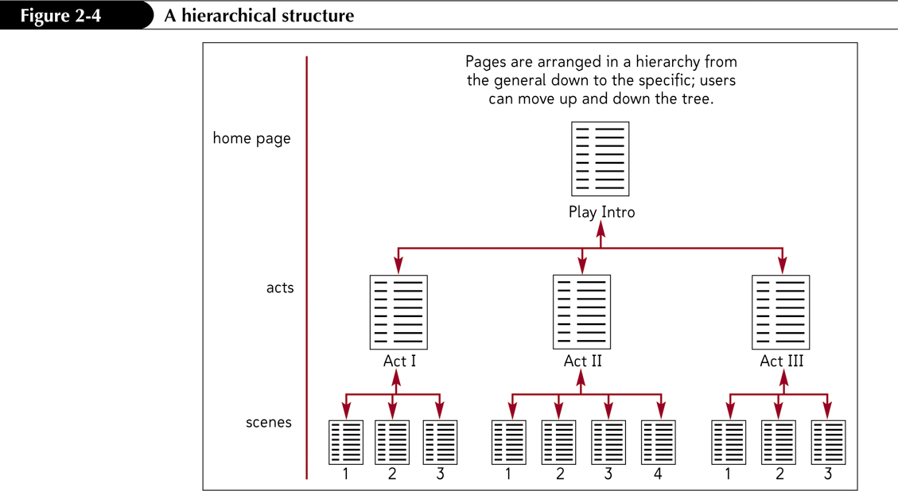
Hierarchical Structures

Slide 9
Mixed Structures
As Web sites become larger and more complex, you often need to use a combination of several different structures
The overall form can be hierarchical, allowing the user to move from general to specific; however, the links also allow users to move through the site in a linear fashion
A site index is a page containing an outline of the entire site and its contents

Slide 10
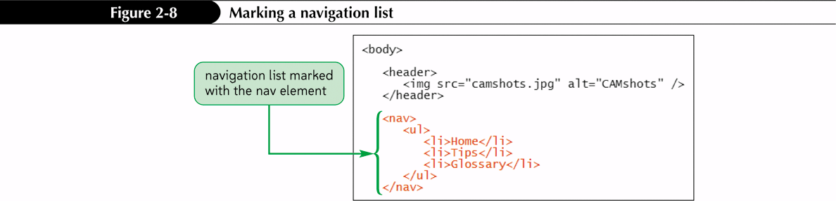
Creating a Navigation List
Every Web site should include a navigation list, which is a list containing links to the main topic areas of the site
HTML5 introduced the nav structural element to make it easier to mark up navigation lists

Slide 11
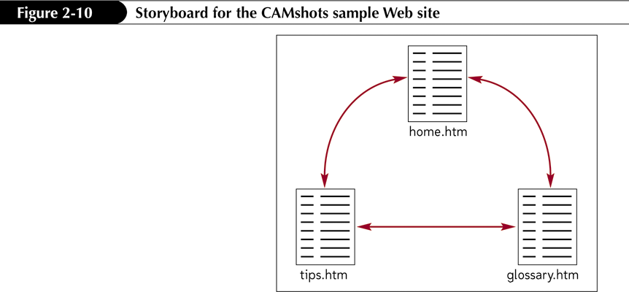
Creating a Hypertext Link

Slide 12
Creating a Hypertext Link
Hypertext links are created by enclosing some document content within a set of opening and closing <a> tags
To mark content as a hypertext link, use
<a href=”reference”>content</a>
where reference is the location being linked to and content is the document content that is being marked as a link

Slide 13
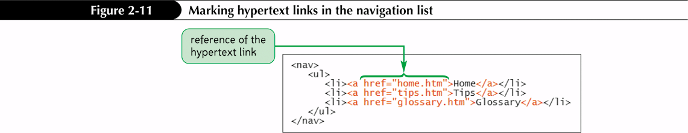
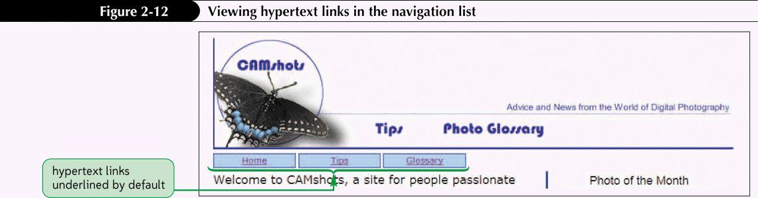
Creating a Hypertext Link
Notes:
Figures 2-11 – 2-12

Slide 14
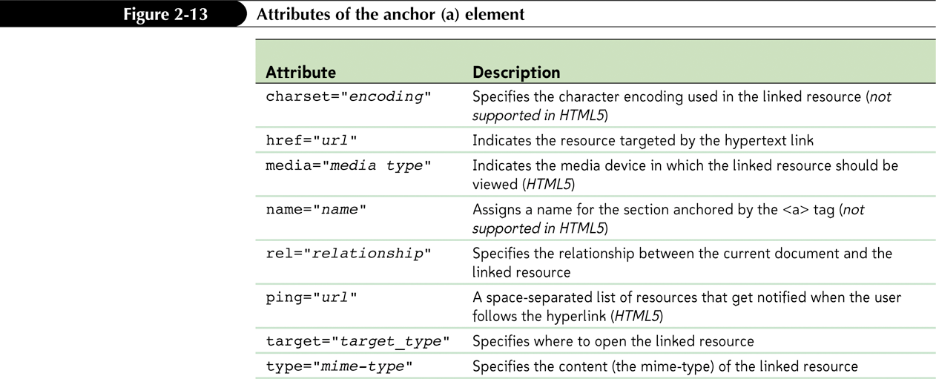
Attributes of the a Element

Slide 15
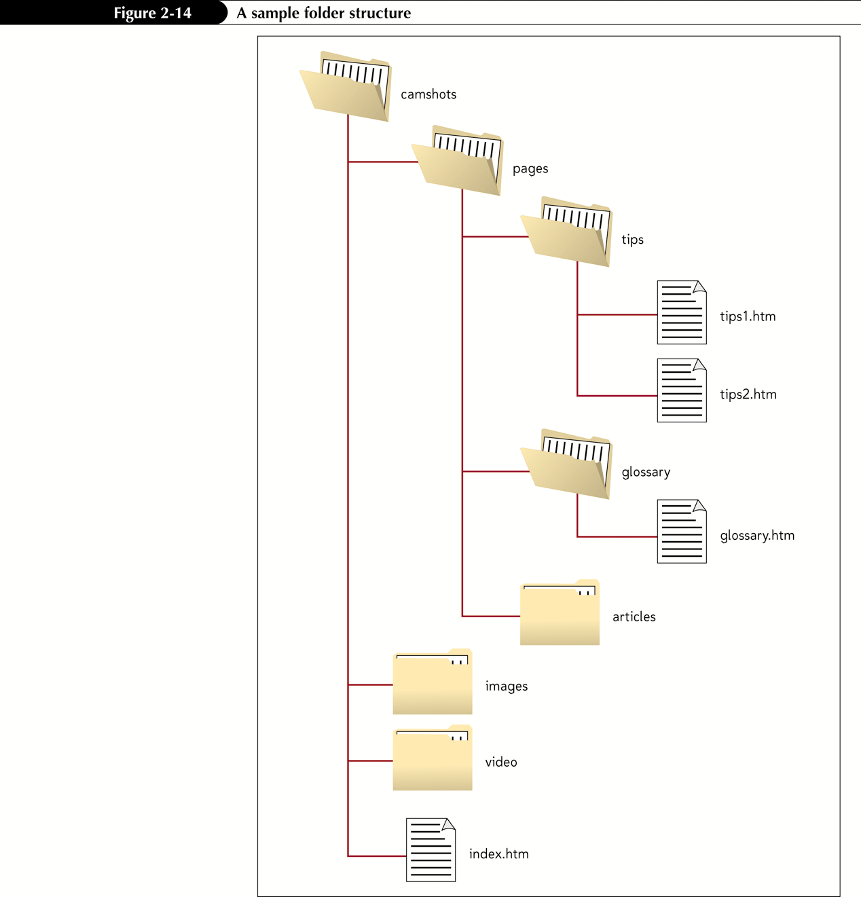
Specifying a Folder Path

Slide 16
Specifying a Folder Path
To create a link to a file located in a different folder than the current document, you must specify the file’s location, or path
An absolute path specifies a file’s precise location within a computer’s entire folder structure
A relative path specifies a file’s location in relation to the location of the current document
If the file is in the same location as the current document, you do not have to specify the folder name
If the file is in a subfolder of the current document, you have to include the name of the subfolder

Slide 17
Specifying a Folder Path
If you want to go one level up the folder tree, you start the relative path with a double period (..), a forward slash, and then provide the name of the file
To specify a different folder on the same level, known as a sibling folder, you move up the folder tree using the double period (..) and then down the tree using the name of the sibling folder
You should almost always use relative paths in your links

Slide 18
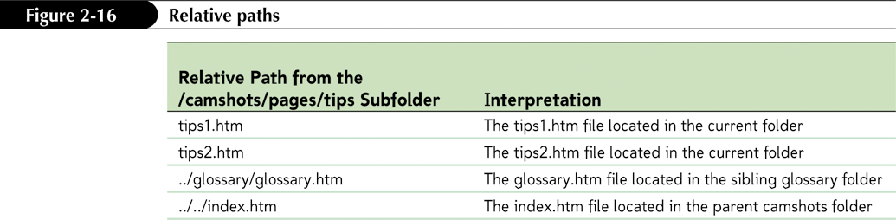
Specifying a Folder Path

Slide 19
Setting the Base Path
A browser resolves relative paths based on the location of the current document
You can change this behavior by using the base element to specify a different starting location for all relative paths
To set the default location for a relative path, add the element
<base href=”path” />
to the document head, where path is the folder location that you want browsers to use when resolving relative paths in the current document

Slide 20
Marking Locations with the id Attribute
To jump to a specific location within a document, you first need to mark that location
One way to identify elements in an HTML document is to use the id attribute
Id names must be unique
Id names are not case sensitive

Slide 21
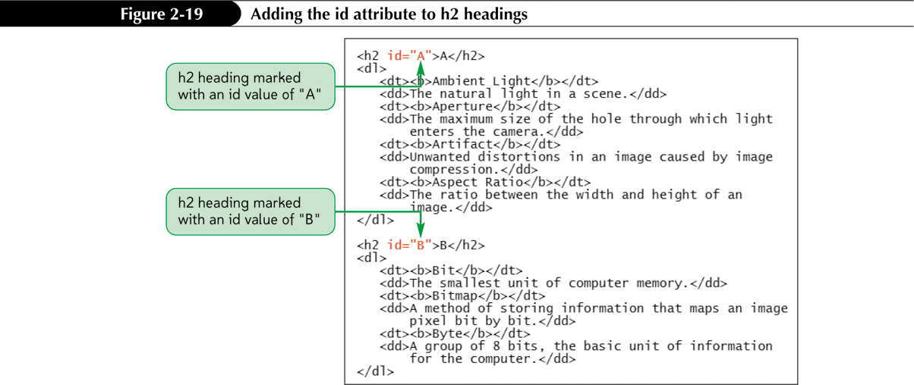
Linking to Locations within Documents

Slide 22
Linking to an id
Once you’ve marked an element using the id attribute, you can create a hypertext link to that element using the a element
<a href=”#id”>content</a>

Slide 23
Creating Links between Documents
To create a link to a specific location in another file, enter the code
<a href="reference#id">content</a>
where reference is a reference to an HTML or XHTML file and id is the id of an element marked within that file

Slide 24
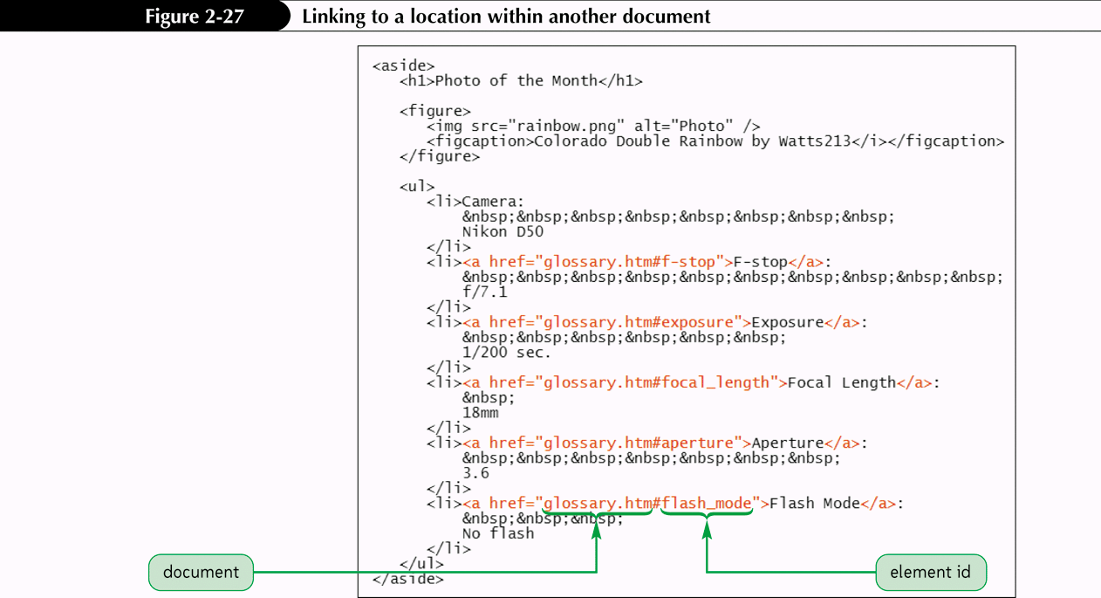
Creating Links between Documents

Slide 25
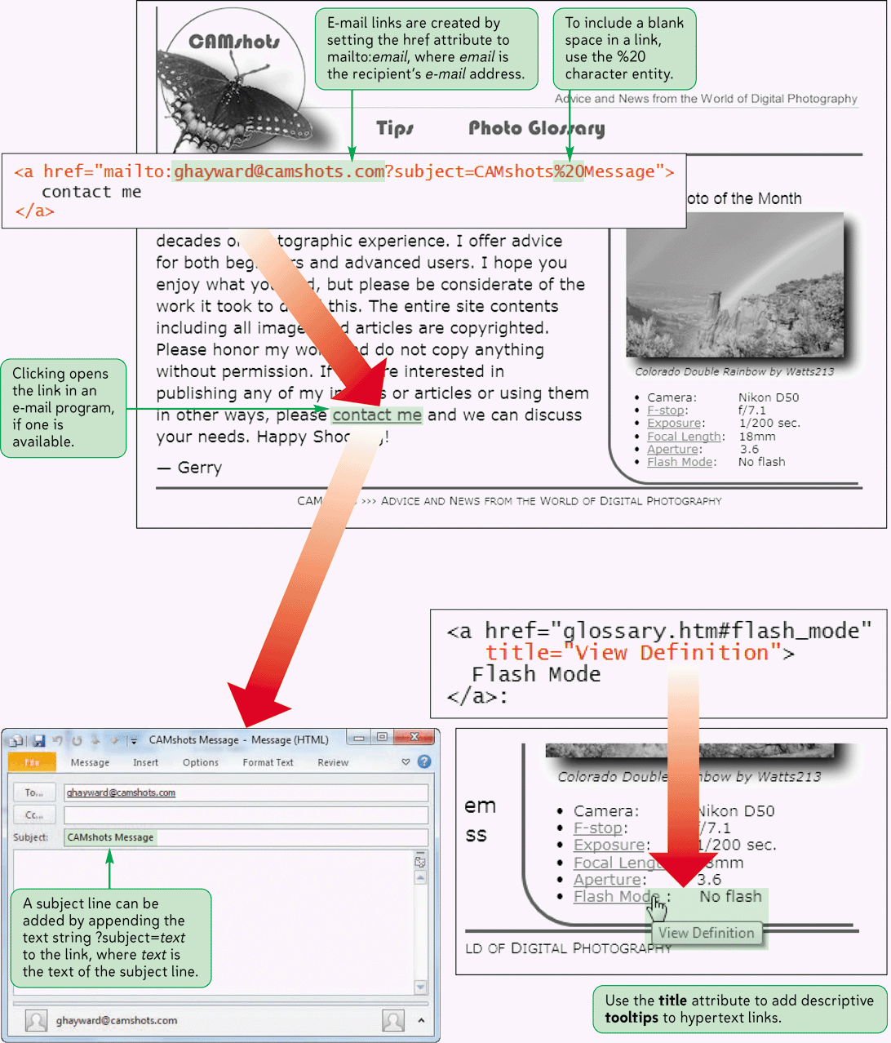
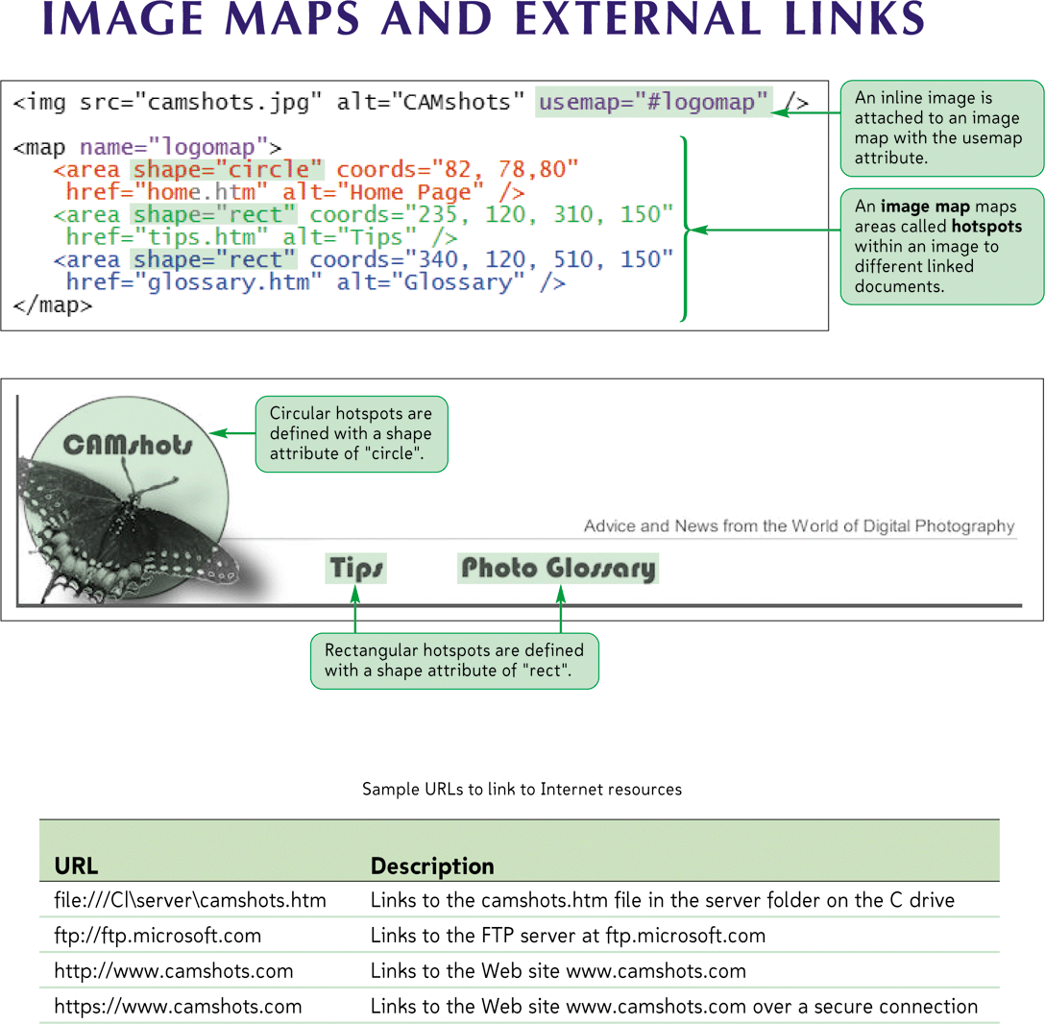
Image Maps and External Links

Slide 26
Working with Linked Images and Image Maps
A standard practice on the Web is to turn the Web site’s logo into a hypertext link pointing to the home page
<a href="reference"><img src="file" alt="text" /></a>
Thumbnail images are small representations of larger image files
HTML also allows you to divide an image into different zones, or hotspots, each linked to a different destination

Slide 27
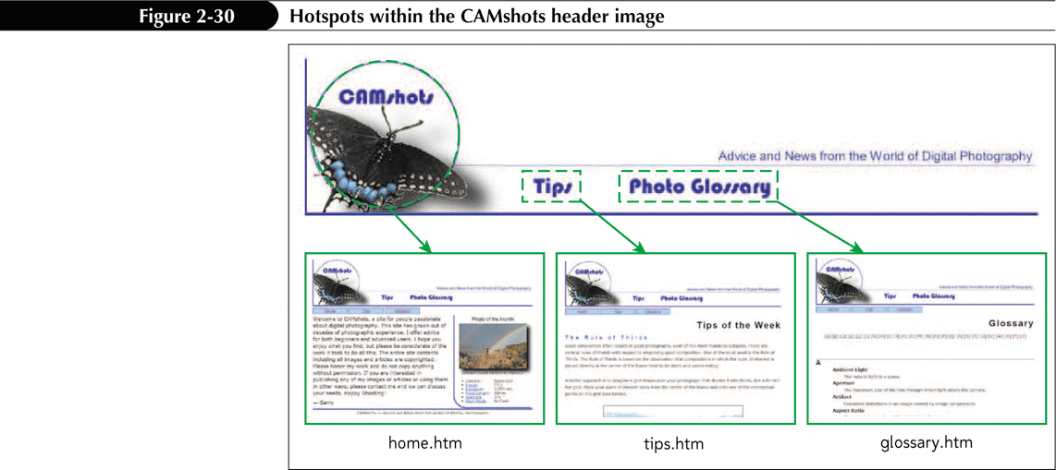
Working with Linked Images and Image Maps

Slide 28
Working with Linked Images and Image Maps
To define these hotspots, you create an image map that matches a specified region of the inline image to a specific destination
HTML supports two kinds of image maps:
Client-side image maps
Server-side image maps

Slide 29
Client-Side Image Maps
A client-side image map is inserted in an image map defined in the Web page
The Web browser locally processes the image map
Because all of the processing is done locally, you can easily test Web pages
More responsive than server-side maps
The browser’s status bar displays the target of each hotspot
Older browsers do not support client-side images

Slide 30
Defining Hotspots
Define a hotspot using two properties:
Its location in the image
Its shape
Syntax of the hotspot element:
<area shape=“shape” coords=“coordinates” href=“url” alt=“text” />

Slide 31
Creating a Rectangular Hotspot
Two points define a rectangular hotspot:
the upper-left corner
the lower-right corner
A sample code for a rectangular hotspot is:
<area shape=“rect” coords=“384,61,499,271” href=“water.htm”>
Coordinates are entered as a series of four numbers separated by commas
HTML expects that the first two numbers represent the coordinates for the upper-left corner of the rectangle, and the second two numbers indicate the location of the lower-right corner
The hotspot is a hypertext link to water.htm

Slide 32
Creating a Circular Hotspot
A circular hotspot is defined by the location of its center and its radius
A sample code for a circular hotspot is:
<area shape=“circle” coords=“307,137,66” href=“karts.htm”>
Coordinates are (307, 137), and it has a radius of 66 pixels
The hotspot is a hypertext link to karts.htm

Slide 33
Creating a Polygonal Hotspot
To create a polygonal hotspot, you enter the coordinates for each vertex in the shape
A sample code for a polygonal hotspot is:
<area shape=“polygon” coords=“13,60,13,270,370,270,370,225,230,225, 230,60” href=“rides.htm”>
Coordinates are for each vertex in the shape
The hotspot is a hypertext link to rides.htm

Slide 34
Creating a Default Hotspot
<area shape="default" coords="0, 0, x, y" … />
where x is the width of the inline image in pixels and y is the image’s height
Any spot that is not covered by another hotspot will activate the default hotspot link

Slide 35
Introducing URLs
To create a link to a resource on the Internet, you need to know its URL
A Uniform Resource Locator (URL) specifies the precise location and type of a resource on the Internet
A protocol is a set of rules defining how information is passed between two resources

Slide 36
Introducing URLs
Your Web browser communicates with Web servers using the Hypertext Transfer Protocol (HTTP)
The URLs for all Web pages must start with the http scheme
Other Internet resources use different protocols and have different scheme names

Slide 37
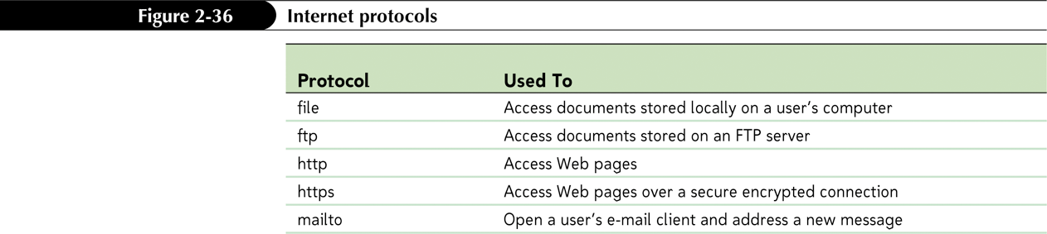
Internet Protocols

Slide 38
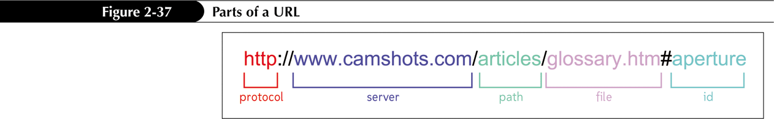
Linking to a Web Site
A sample URL for a Web page

Slide 39
Linking to a Web Site
If a URL includes no path, then it indicates the topmost folder in the server’s directory tree
If a URL does not specify a filename, the server searches for the default home page
The server name portion of the URL is also called the domain name
The top level, called an extension, indicates the general audience supported by the Web server
<a href="http://www.apogeephoto.com">Apogee Photo</a>

Slide 40
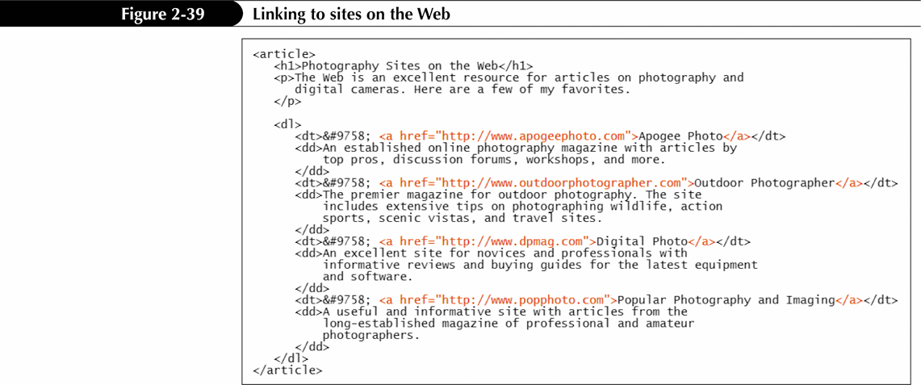
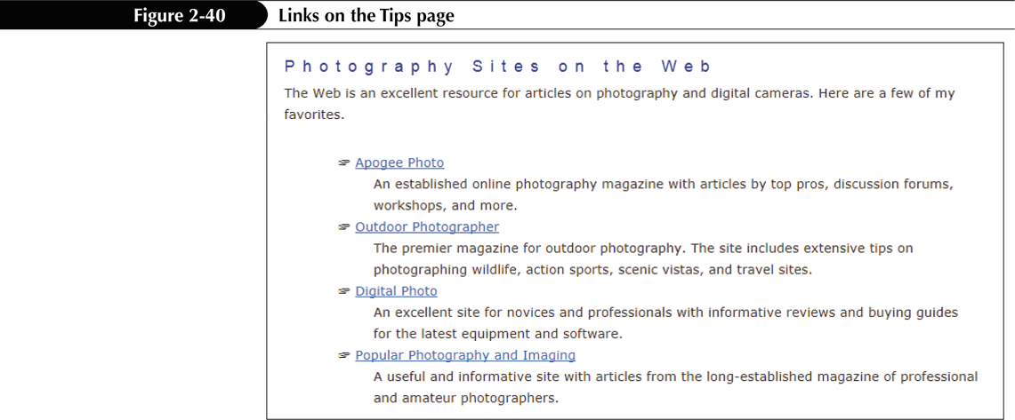
Linking to a Web Site

Slide 41
Linking to FTP Servers
FTP servers are another method of storing and sharing files on the Internet
FTP servers transfer information using a communications protocol called File Transfer Protocol (FTP)
An FTP server requires each user to enter a password and a username to access its files

Slide 42
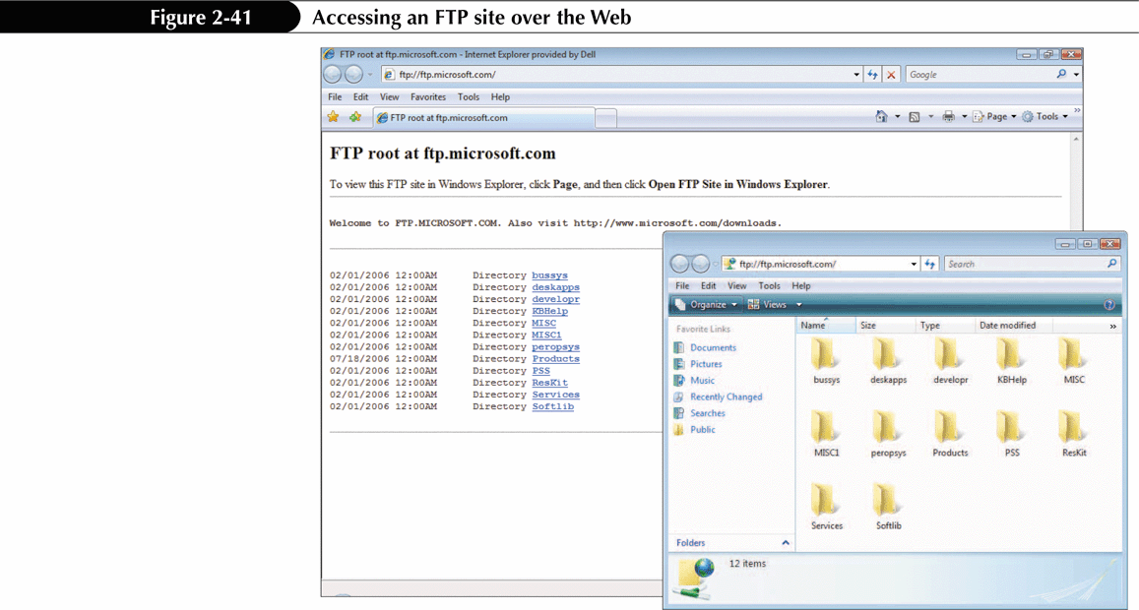
Linking to FTP Servers

Slide 43
Linking to a Local File
On occasion, you may see the URL for a file stored locally on your computer or local area network
If you are accessing a file from your own computer, the server name might be omitted and replaced by an extra slash (/)
The file scheme here does not imply any particular communication protocol; instead the browser retrieves the document using whatever method is the local standard for the type of file specified in the URL

Slide 44
Linking to an E-Mail Address
Many Web sites use e-mail to allow users to communicate with a site’s owner, sales representative, or technical support staff
You can turn an e-mail address into a hypertext link; when a user clicks the link, the user’s e-mail program opens and automatically inserts the address into the “To” field of the new outgoing message

Slide 45
Linking to an E-Mail Address
The mailto protocol also allows you to add information to the e-mail, including the subject line and the text of the message
mailto:address?header1=value1&header2=value2& ...
mailto:ghayward@camshotscom?Subject=Test&Body= This%20is%20a%20test%20message
Spaces are replaced with the %20 character code since URLs cannot contain blank spaces

Slide 46
Linking to an E-Mail Address
If you need to include an e-mail address in your Web page, you can take a few steps to reduce problems with spam:
Replace all e-mail addresses in your page with inline images of those addresses
Write a program in a language JavaScript to scramble any e-mail address in the HTML code
Replace the characters of the e-mail address with escape characters (character codes)

Slide 47
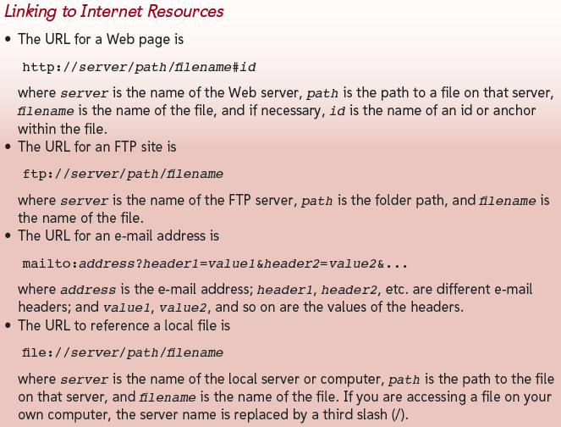
Linking to an E-Mail Address

Slide 48
Working with Hypertext Attributes
HTML provides several attributes to control the behavior and appearance of your links
You can force a document to appear in a secondary window or tab by adding the target attribute to the tag <a> tag
If you want to provide additional information to your users, you can provide a tooltip to your links
A tooltip is a descriptive text that appears whenever a user positions the mouse pointer over a link

Slide 49
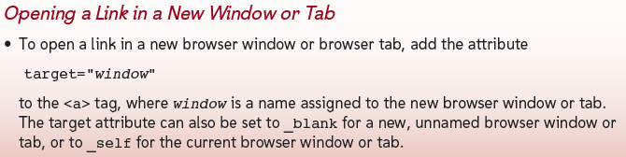
Working with Hypertext Attributes

Slide 50
Using the link Element
Another way to add a link to your document is to add a link element to the document’s head
Link elements are intended only for the browser’s use
Link elements do not appear as part of the Web page

Slide 51
Working with Metadata
Web authors often turn to search engine optimization (SEO) tools to make their sites appear more prominently in search engines.
Information about the site is called metadata
Add metadata to your Web pages by adding a meta element to the head section of the document
<meta name="text" content="text" scheme="text" http-equiv="text" />

Slide 52
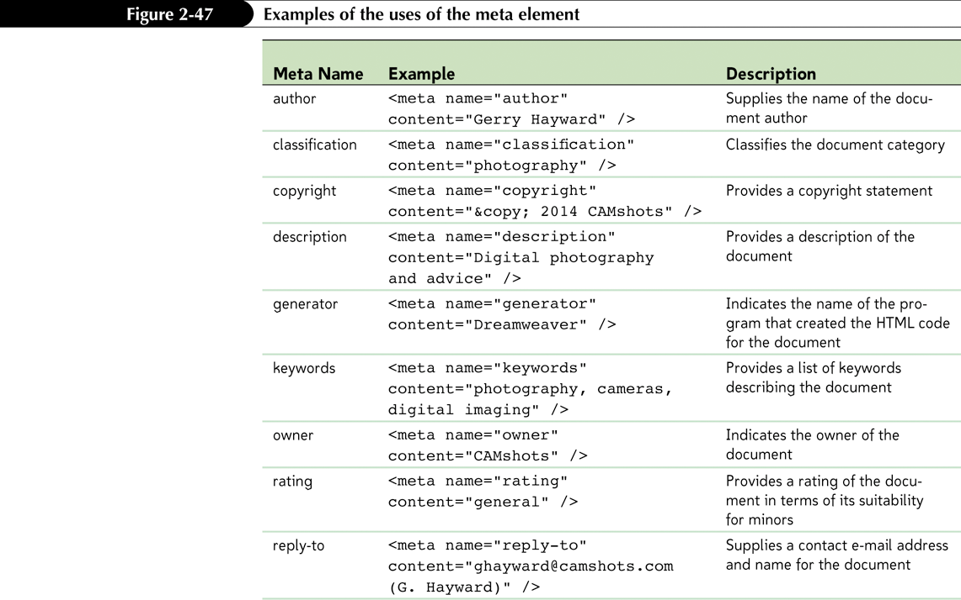
Working with Metadata

Slide 53
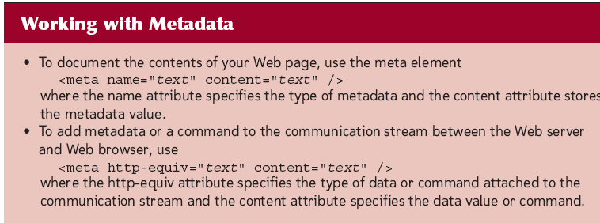
Working with Metadata
In recent years, search engines have become more sophisticated in evaluating Web sites
The meta element has decreased in importance, but it is still used by search engines when adding a site to their indexes

Slide 54
Working with Metadata
You can add information and commands to this communication stream with the meta element’s http-equiv attribute of the meta element
Force the Web browser to refresh the Web page at timed intervals
<meta http-equiv="refresh" content="60" />
Redirect the browser from the current document to a new document
<meta http-equiv="refresh" content="5;url=www.camshots.com" />

